Slide 1
Client and Server application
Rohan Napit

Slide 2

What is client server application
It is an application that consists of a client program that consumes services provided by a server program.
The client requests services from the server by calling functions in the server application.
In a distributed computing environment, where the client program and the server program execute on different machines and possibly even on different platforms, the client and server communicate through a communications layer that is often called middleware.

Slide 3
Features of client server application
A client program can request services from multiple server programs
A client program does not need to be aware of the actual subprograms that provide a service
Multiple subprograms can work together to provide the service
Multiple client programs can request services from a single server program
A server program can provide multiple services
Typically, the server program runs on a machine that is remote from the machine running the client program

Slide 4
Client/Server benefits
Re-use existing legacy code for the business logic
Run each functional layer of the application on the platform most suited to the task
Distribute the processing and network loads
Quickly and easily change business logic procedures without changing the client program or user interface
Provide simple and convenient delivery of the application and any updates to end-users
Provide alternative client user interfaces to the same server-side program
Use development tools that are designed to work together

Slide 5
Client Server application
Java Socket programming is used for communication between the applications running on different JRE.
Java Socket programming can be connection-oriented or connection-less.
Socket and ServerSocket classes are used for connection-oriented socket programming and DatagramSocket and DatagramPacket classes are used for connection-less socket programming.
The client in socket programming must know two information:
1. IP Address of Server, and
2. Port number.

Slide 6
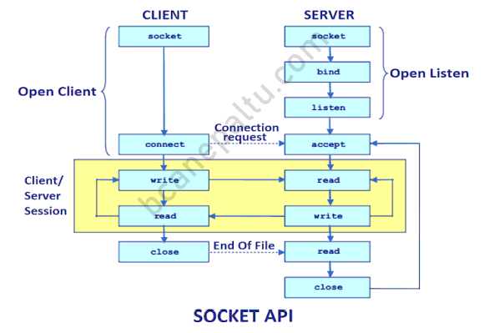
Client Server application

Slide 7
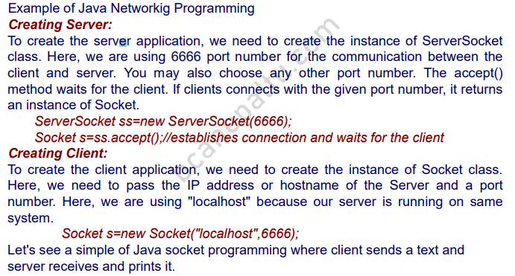
Client Server application

Slide 8
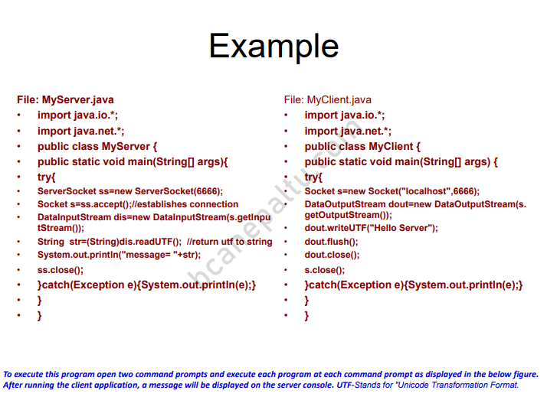
Client Server application

Slide 9
Thank you

